Slide 1
Test Stubs
... getting the world under control

Slide 2
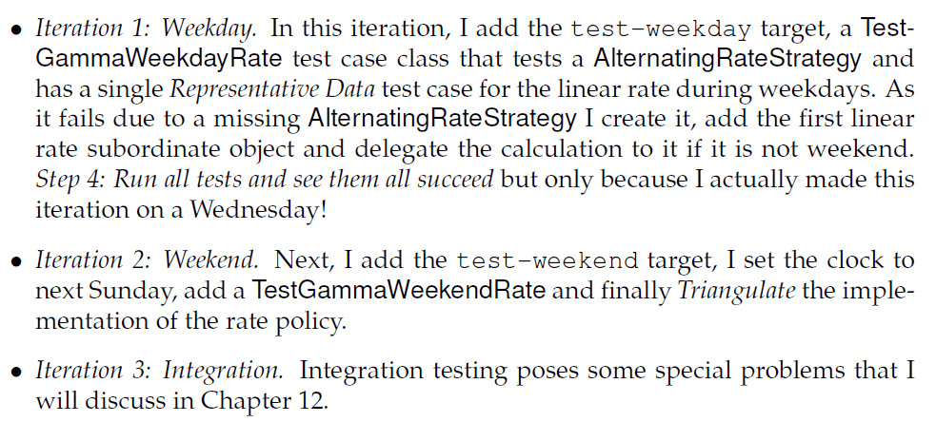
TDD of State Pattern
To implement GammaTown requirements I
CS, AU
Henrik Bærbak Christensen

Slide 3
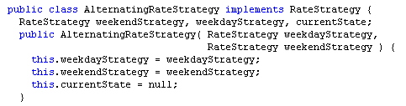
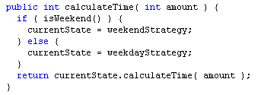
Resulting Production Code
public boolean isWeekend() { ... }
Read system clock to determine if weekend
CS, AU
Henrik Bærbak Christensen

Slide 4
Requirement
After introducing Gammatown I no longer have automated tests because I have to run some of the tests during the weekend.
  I have a ‘manual run on weekend and another run on weekdays targets’
I want to get back to as much automated testing as possible.
CS, AU
Henrik Bærbak Christensen

Slide 5
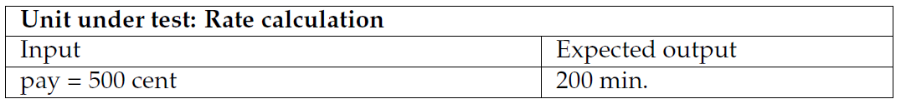
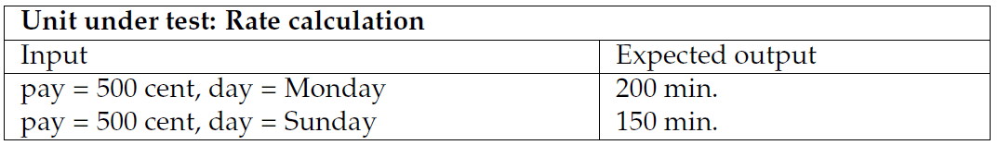
Tricky Requirement
The test case for AlphaTown:
… problematic for GammaTown…
CS, AU
Henrik Bærbak Christensen

Slide 6
Analysis
Gammatown, however, has one more parameter in the rate policy test case
The problem is
This parameter is not accessible from the testing code!
CS, AU
Henrik Bærbak Christensen

Slide 7

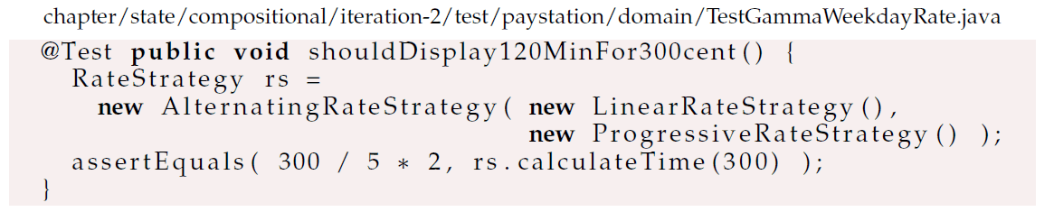
Code view
Direct input parameter: payment
Indirect input parameter: day of week
CS, AU
Henrik Bærbak Christensen

Slide 8
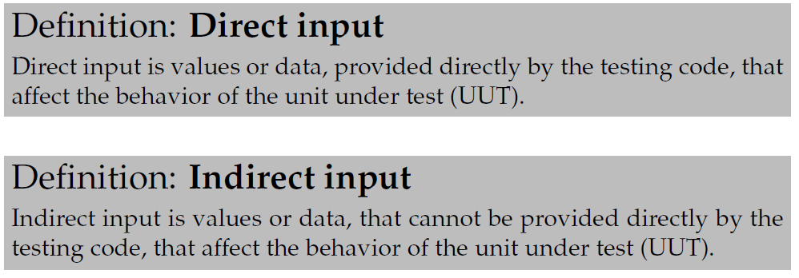
Definitions
This reflection allows me to classify parameters:
UUT = Unit Under Test.
  here it is the RateStrategy instance...
CS, AU
Henrik Bærbak Christensen

Slide 9
Where does indirect input come from?
So the 1000$ question is: where does the indirect input parameter come from?
Exercise: Name other types of indirect input?
CS, AU
Henrik Bærbak Christensen
Notes:
Hardware sensor readings, clock, system variables, input from configuration files, system.in, a pop-up dialogue box

Slide 10
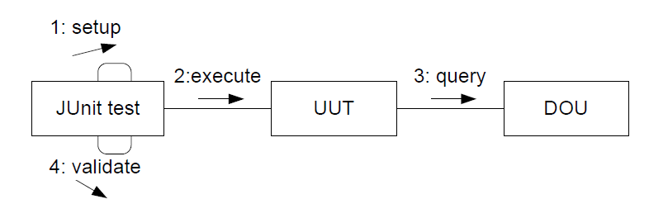
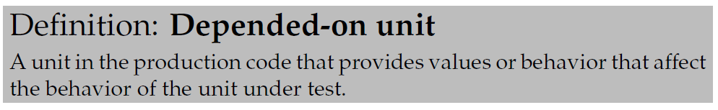
Analysis: Code view
Structure of xUnit test cases
Here
  box = executing unit
  Collaboration diagram: interaction between objects
DOU = Depended On Unit
CS, AU
Henrik Bærbak Christensen

Slide 11
Direct versus Indirect
Direct input
Indirect input
CS, AU
Henrik Bærbak Christensen

Slide 12
The Gammatown Rate Policy
My DOU is the C#/Java system clock:
System Clock
System.DateTime
java.util.Calendar
Test code
AlternatingRateStrategy
Method parameters
Calling library methods
CS, AU
Henrik Bærbak Christensen

Slide 13
The Challenge
This analysis allows me to state the challenge:
How can I make the DOU return values that are defined by the testing code?
System Clock
System.DateTime
java.util.Calendar
Test code
AlternatingRateStrategy
CS, AU
Henrik Bærbak Christensen

Slide 14
Analysis
Basically it is a variability problem
  During testing, use data given by test code
  During normal ops, use data given by system
So I can reuse my previous analysis
  parametric proposal
  polymorphic proposal
  compositional proposal
CS, AU
Henrik Bærbak Christensen

Slide 15
Parametric
This is perhaps the oldest solution in the C world
#ifdef DEBUG
today = PRESET_VALUE;
#else
today = (get date from clock);
#
return today == Saturday || today == Sunday;
CS, AU
Henrik Bærbak Christensen

Slide 16
Polymorphic
Subclass or die...
Actually a quite reasonable approach...
Argue why!!!
AlternatingRateStrategy
Override ‘isWeekend()’
method
TestAlternatingRateStrategy
CS, AU
Henrik Bærbak Christensen

Slide 17
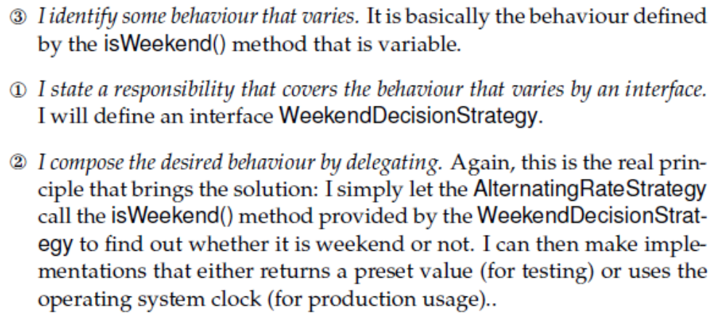
Compositional
3-1-2 leads to yet another Strategy Pattern:
CS, AU
Henrik Bærbak Christensen

Slide 18
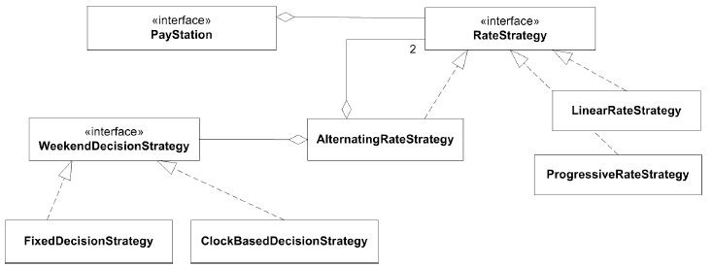
Static Architecture View
Exercise: Why is this Strategy and not State?
CS, AU
Henrik Bærbak Christensen

Slide 19
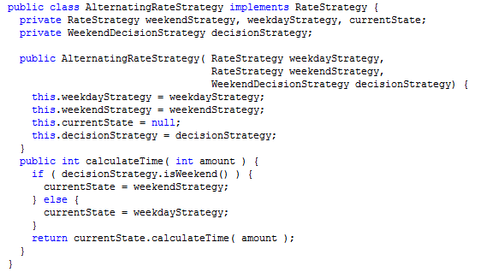
Code View
CS, AU
Henrik Bærbak Christensen

Slide 20
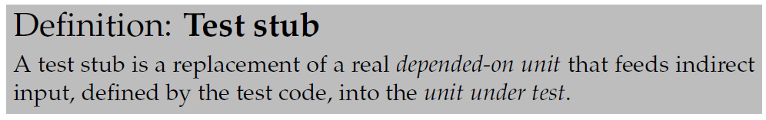
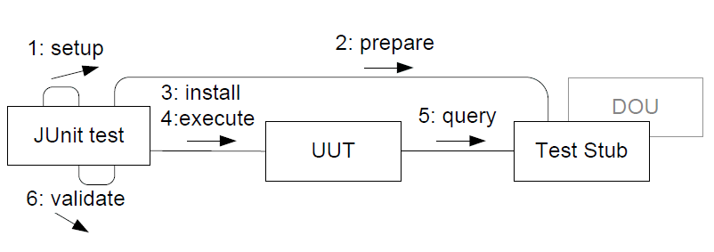
Test Stub
I have made a test stub
CS, AU
Henrik Bærbak Christensen

Slide 21
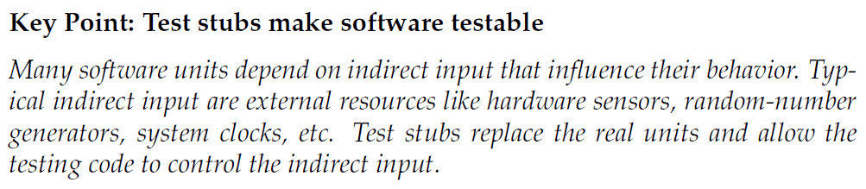
Key point
CS, AU
Henrik Bærbak Christensen

Slide 22
Note
(Please note that once again the 3-1-2 is the underlying and powerful engine for Test Stub. I use the 3-1-2 to derive a solution that “accidentally” has a name and is a well known concept; just as I previously derived several design patterns.)
CS, AU
Henrik Bærbak Christensen

Slide 23
The Code View
CS, AU
Henrik Bærbak Christensen

Slide 24
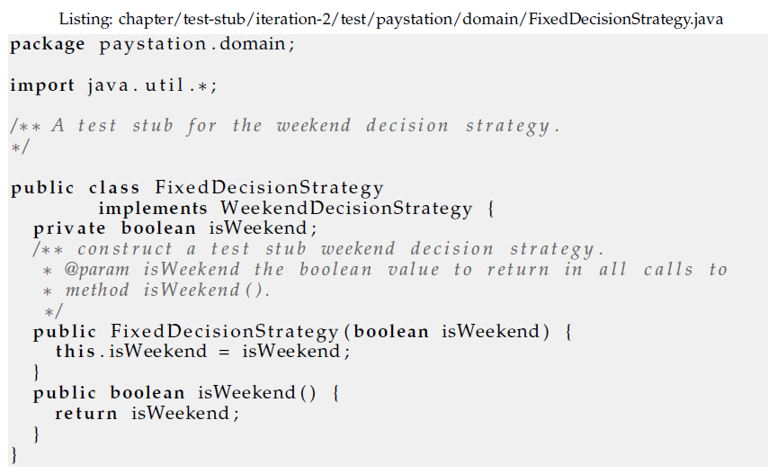
The Stub
CS, AU
Henrik Bærbak Christensen

Slide 25
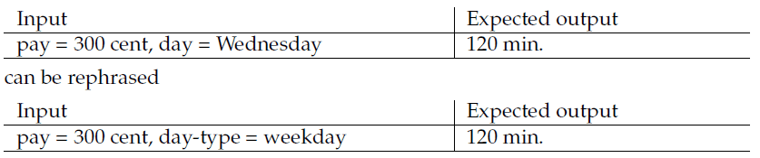
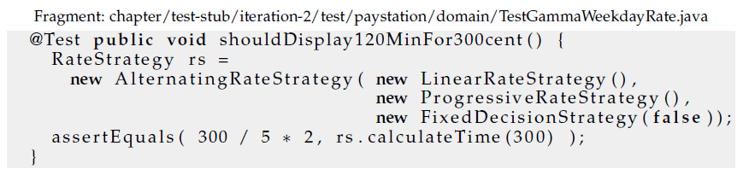
Setting it up
Direct input parameter: payment
Now: Direct input parameter: weekend or not
CS, AU
Henrik Bærbak Christensen

Slide 26
Reusing the variability points...
Aah – I could do this...
CS, AU
Henrik Bærbak Christensen

Slide 27
Variability points to the rescue
The WeekendDecisionStrategy introduces yet another variability point...
Often they come in handy later if 1) they encapsulate well-defined responsibilities 2) are defined by interfaces and 3) uses delegation ☺
CS, AU
Henrik Bærbak Christensen

Slide 28
Static Architecture View
CS, AU
Henrik Bærbak Christensen

Slide 29
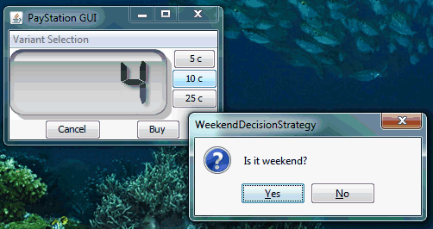
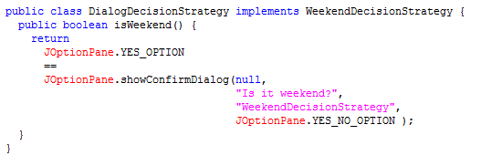
Manual testing
Manual testing of GammaTown
CS, AU
Henrik Bærbak Christensen

Slide 30
Discussion
CS, AU
Henrik Bærbak Christensen

Slide 31
Test Doubles
Test Stub is a subtype of Test Double. Other sub types exists:
  Stub: Get indirect input under control
  Spy: Get indirect output under control
    to validate that UUT use the proper protocol
      count method calls, ensure proper call sequence
  Mock: A spy with fail fast property
    Frameworks exists that test code can ‘program’ mocks without every coding them in the native language
    Fail fast: fail on first breaking of protocol
  Fake: A lightweight but realistic double
    when the UUT-DOU interaction is slow and tedious
    when the Double interaction is not the purpose of test
CS, AU
Henrik Bærbak Christensen

Slide 32
Package/Namespace View
I always organize folder hierarchy into two
  src: all production code rooted here
  test: all test code rooted here
Here
  WeekendDecisionStrategy (interface)
  ClockBasedDecisionStrategy (class)
  FixedDecisionStrategy (class)
Exercise: Where would you put these units?
CS, AU
Henrik Bærbak Christensen
Notes:
Fixed should be in test tree as it should not be deployed at customer site

Slide 33
C# Delegates
The strategy only contains a single method and having an interface may seem a bit of an overkill.
  In Java there are however few alternatives
  In C# you may more elegantly (= save some typing) use delegates that is more or less a type safe function pointer.
  In functional languages you may use closures
CS, AU
Henrik Bærbak Christensen

Slide 34
Summary

Slide 35
Key Points
Test Stubs make software testable.
3-1-2 technique help isolating DOUs
  because I isolated the responsibility by an interface I had the opportunity to delegate to a test stub
My solution is overly complex
  Yes! Perhaps subclassing would be better here.
  But
    it scales well to complex DOUs
    it is good at handling aspects that may vary across the entire system (see next slide)
CS, AU
Henrik Bærbak Christensen

Slide 36
Analysis
The WDStrategy is local. If there was many places in production code that needed to vary behaviour depending on weekend or not, then:
CS, AU
Henrik Bærbak Christensen

Slide 37
Still Untested Code
Some code units are not automatically testable in a cost-efficient manner
  Note that if I rely on the automatic tests only, then the ClockBasedDecisionStrategy instance is never tested!
    (which it actually was when using the manual tests!)
Thus:
  DOUs handling external resources must still be manually tested (and/or formally reviewed).
  Isolate them to a minimum, and if it ain’t broke, then don’t fix it ☺
CS, AU
Henrik Bærbak Christensen

Slide 38
Know When to Stop Testing
Note also that I do not test that the return values from the system library methods are not tested.
I expect Sun / MicroSoft to test their software.
  sometimes we are wrong but it is not cost efficient.
Do not test the random generator ☺
CS, AU
Henrik Bærbak Christensen

